Slide 1

/Introduction to Kali Linux (and Linux)
WORKSHOP.HTML

Slide 2
DISCLAIMER !!!
This workshop is intended for educational purposes only
Do NOT perform scans/information gathering on any system/entity without explicit permission to do so.
NullSec will NOT be accountable if you use skills and knowledge shared to perform illegal or malicious attacks
WORKSHOP.HTML

Slide 3
/TABLE OF CONTENTS
/01
/Intro to Linux
/02
/Linux Navigation and Usage
/03
/Intro to Kali Linux
/04
/Kali Linux Tools
What is Linux?
Differences between CLI and GUI + Useful tools
Essential CLI commands for navigation and file management
Introducing some Kali Linux tools
/05
/CTF
Test your knowledge!
WORKSHOP.HTML

Slide 4
/01
/Intro to Linux
WORKSHOP.HTML

Slide 5





What is Linux?
An open-source kernel built by Linux Torvalds in 1991
Generally used in reference to Operating Systems built on the kernel
Common alternative to Windows, and MacOS
Popular flavours of Linux include Ubuntu, Mint, Fedora, and Kali Linux
Notes:
Kernels exists at the core of operating systems,
Add comparisons

Slide 6
/Why Linux?
/Open Sourced
/Customizability
/Compatibility
Anyone can contribute to most Linux operating systems
Source code is open to public
Various distros available to suit different needs
Lightweight versions for older hardware, and specialised versions for pen testing
Linux supports a wide range of hardware platforms and architectures
versatile for use on desktops, servers, mobile devices, and embedded systems.
WORKSHOP.HTML

Slide 7
/ Types of User Interfaces
/Graphical User Interface (GUI)
/Command Line Interface(CLI)
GUI is user-friendly and intuitive, making it accessible for beginners and those who prefer visual interactions.
CLI is powerful and efficient for experienced users, ideal for automation and remote management.
WORKSHOP.HTML

Slide 8
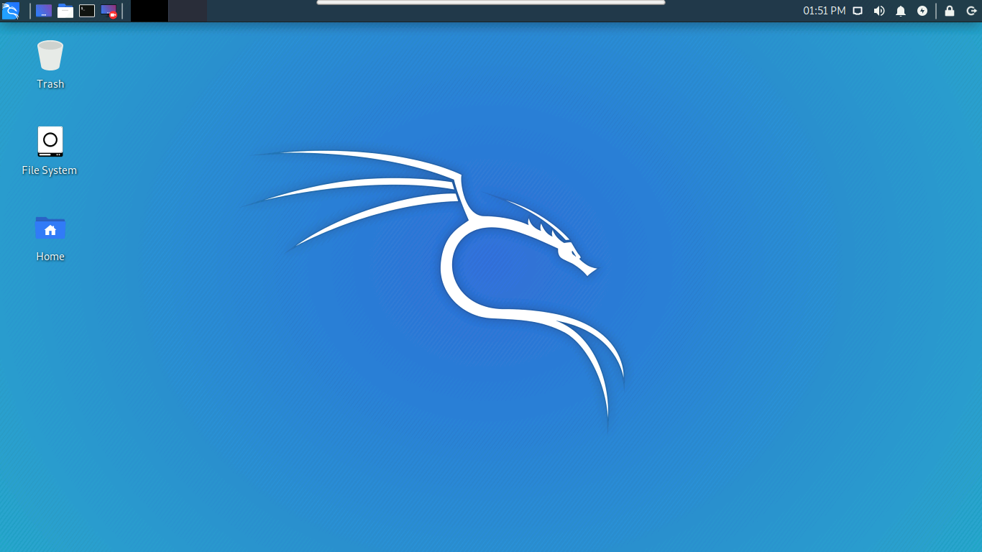
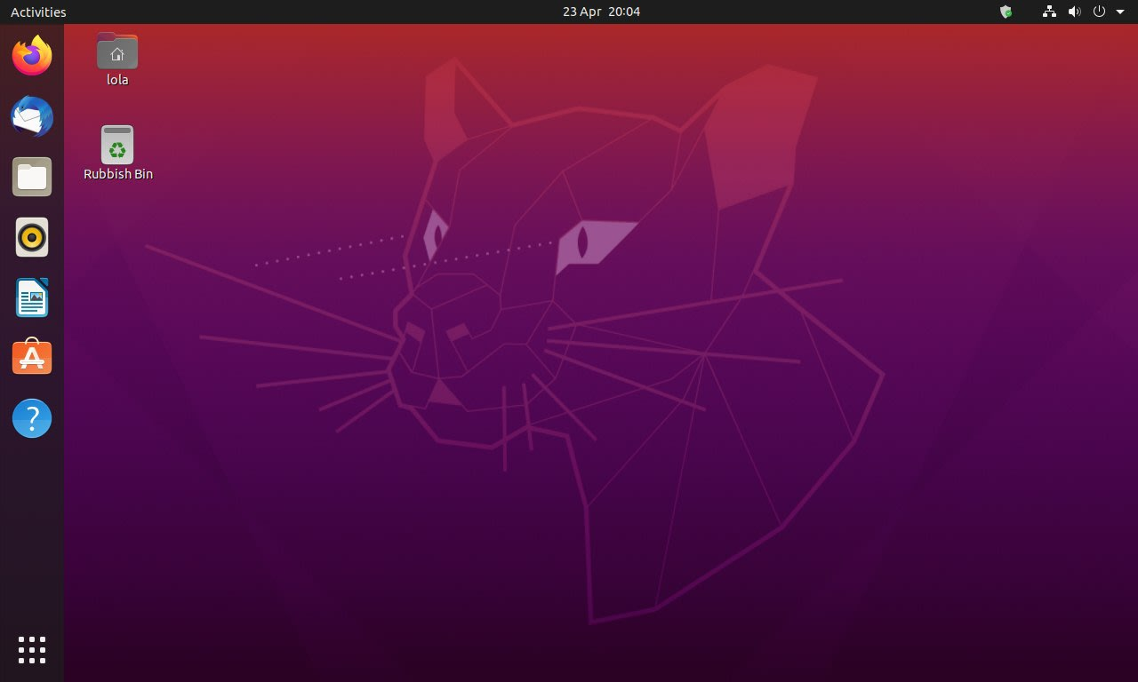
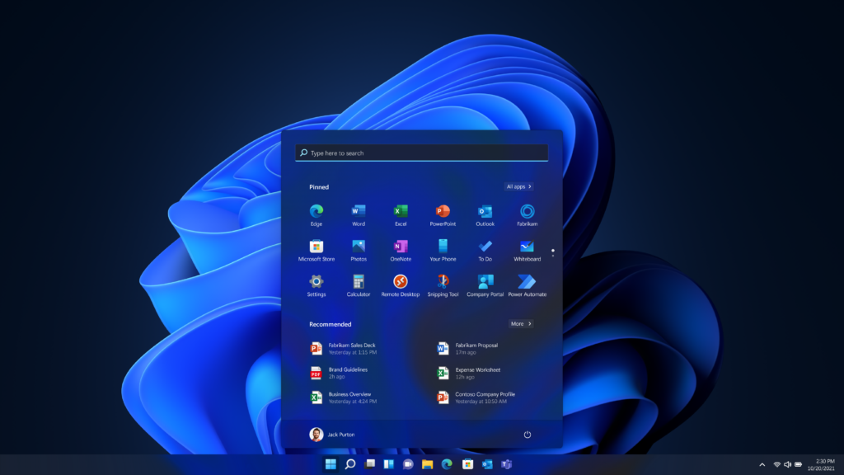
GUI
Most modern operating systems today possess a graphical user interface, to accommodate a wide range of users.
Kali Linux
Ubuntu
Windows

Slide 9
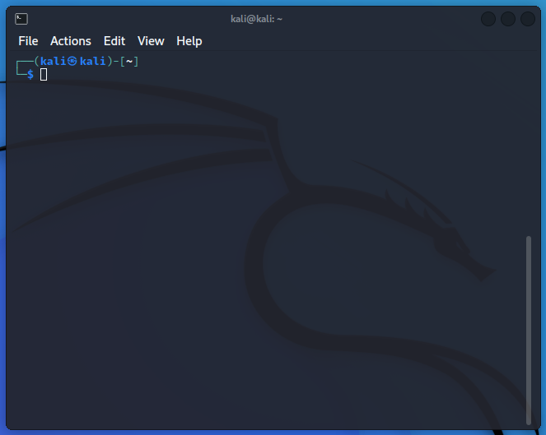
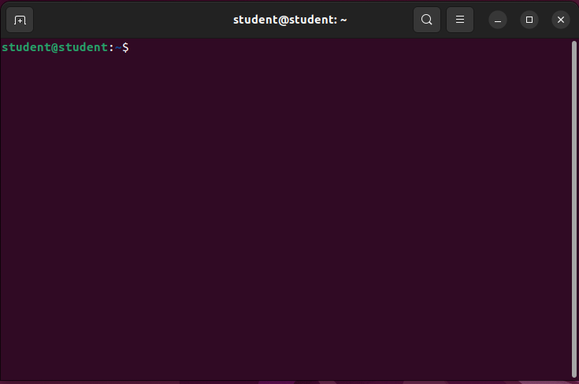
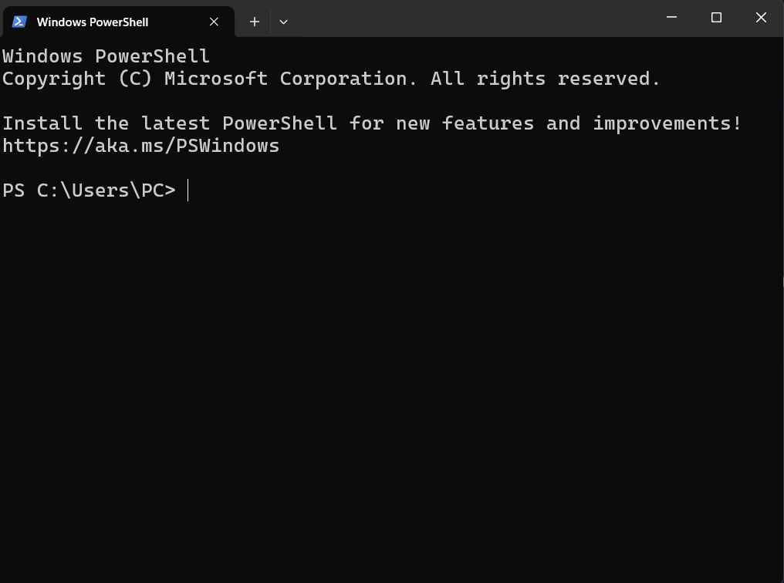
CLI
Used by individuals with more technical knowhow, commonly used on Linux OSes, especially system administration.
Kali Linux (ZSH)
Ubuntu (BASH)
Windows (Powershell)

Slide 10
/02
Linux Navigation and Usage
WORKSHOP.HTML

Slide 11
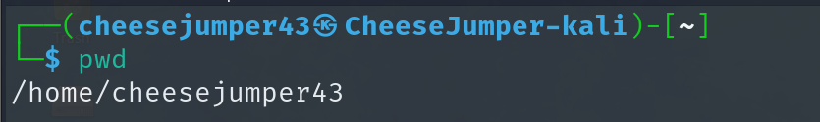
ZSH Shell Interface
Username – cheesejumper43
Hostname – CheeseJumper43-kali
Current Working Directory - ‘/home/cheesejumper43’(~)
Notes:
Kernels exists at the core of operating systems,

Slide 12
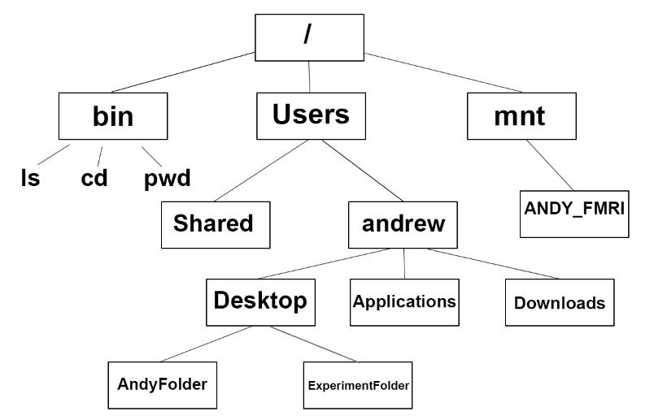
Linux file system
Tree-like structure
Base of the file system is the root (/)
All the folders, and sub folders ‘extend’ from the root
Home directory is generally found in ‘/home/<username>’
Root user’s home directory is found in ‘/root’
Notes:
Image sourced from: https://andysbrainbook.readthedocs.io/en/stable/unix/Unix_01_Navigation.html

Slide 13
Shorthand notations
Notation | Refers to
. (single period) | Current directory
.. (double period) | Parent directory
/ (slash) | Root directory
~ (tilde) | Home directory

Slide 14
Sample file path types
/
home/
bob/
Desktop/
file.txt
Absolute file path: Start from root
/home/bob/Desktop/file.txt
File name
Home directory of bob
Desktop Directory of Bob
./
Desktop/
File.txt/
Relative file path: Start from present directory (/home/bob)
./Desktop/file.txt

Slide 15
Command Structure
Cmd name
input1
input2
input…
Sample command 1: pwd (No extra inputs required)
Sample command 2: touch file.txt (1 input provided)
Sample command 3: rm –r directory1 (2 inputs provided)

Slide 16
Common Navigation Commands
pwd​ | print current working directory path​
ls​ | list files and directories in working location​
clear ​ | Clear text on terminal
cd <dirpath>​ | change to specified directory​ path

Slide 17
PWD
Print working directory
pwd

Slide 18
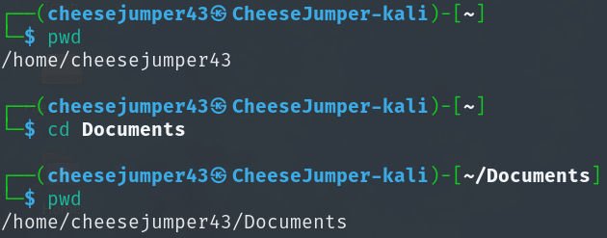
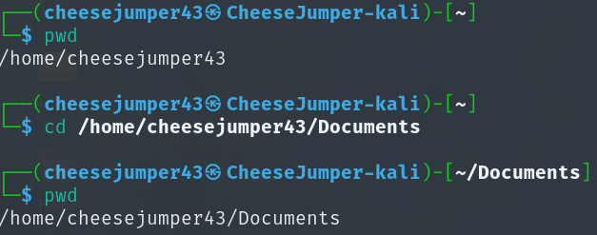
CD
Relative Path (‘.’ Can be omitted)
Absolute path
Change Directory
cd

Slide 19
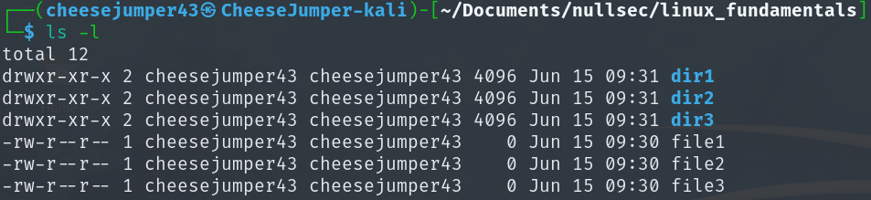
LS
ls: List files and directories
ls –l: Display additional info (Long format)
ls –a: Display all files (even hidden files)
Hint:
Order of options do not matter.
Options can be chained: -la
(list all files in long format)
List
ls

Slide 20
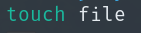
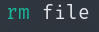
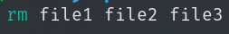
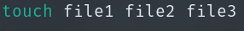
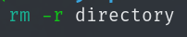
File management
Remove a single file
Create a single file
Remove multiple files
Create multiple files
Remove files recursively in populated directory
Create file
Remove file
touch
rm

Slide 21


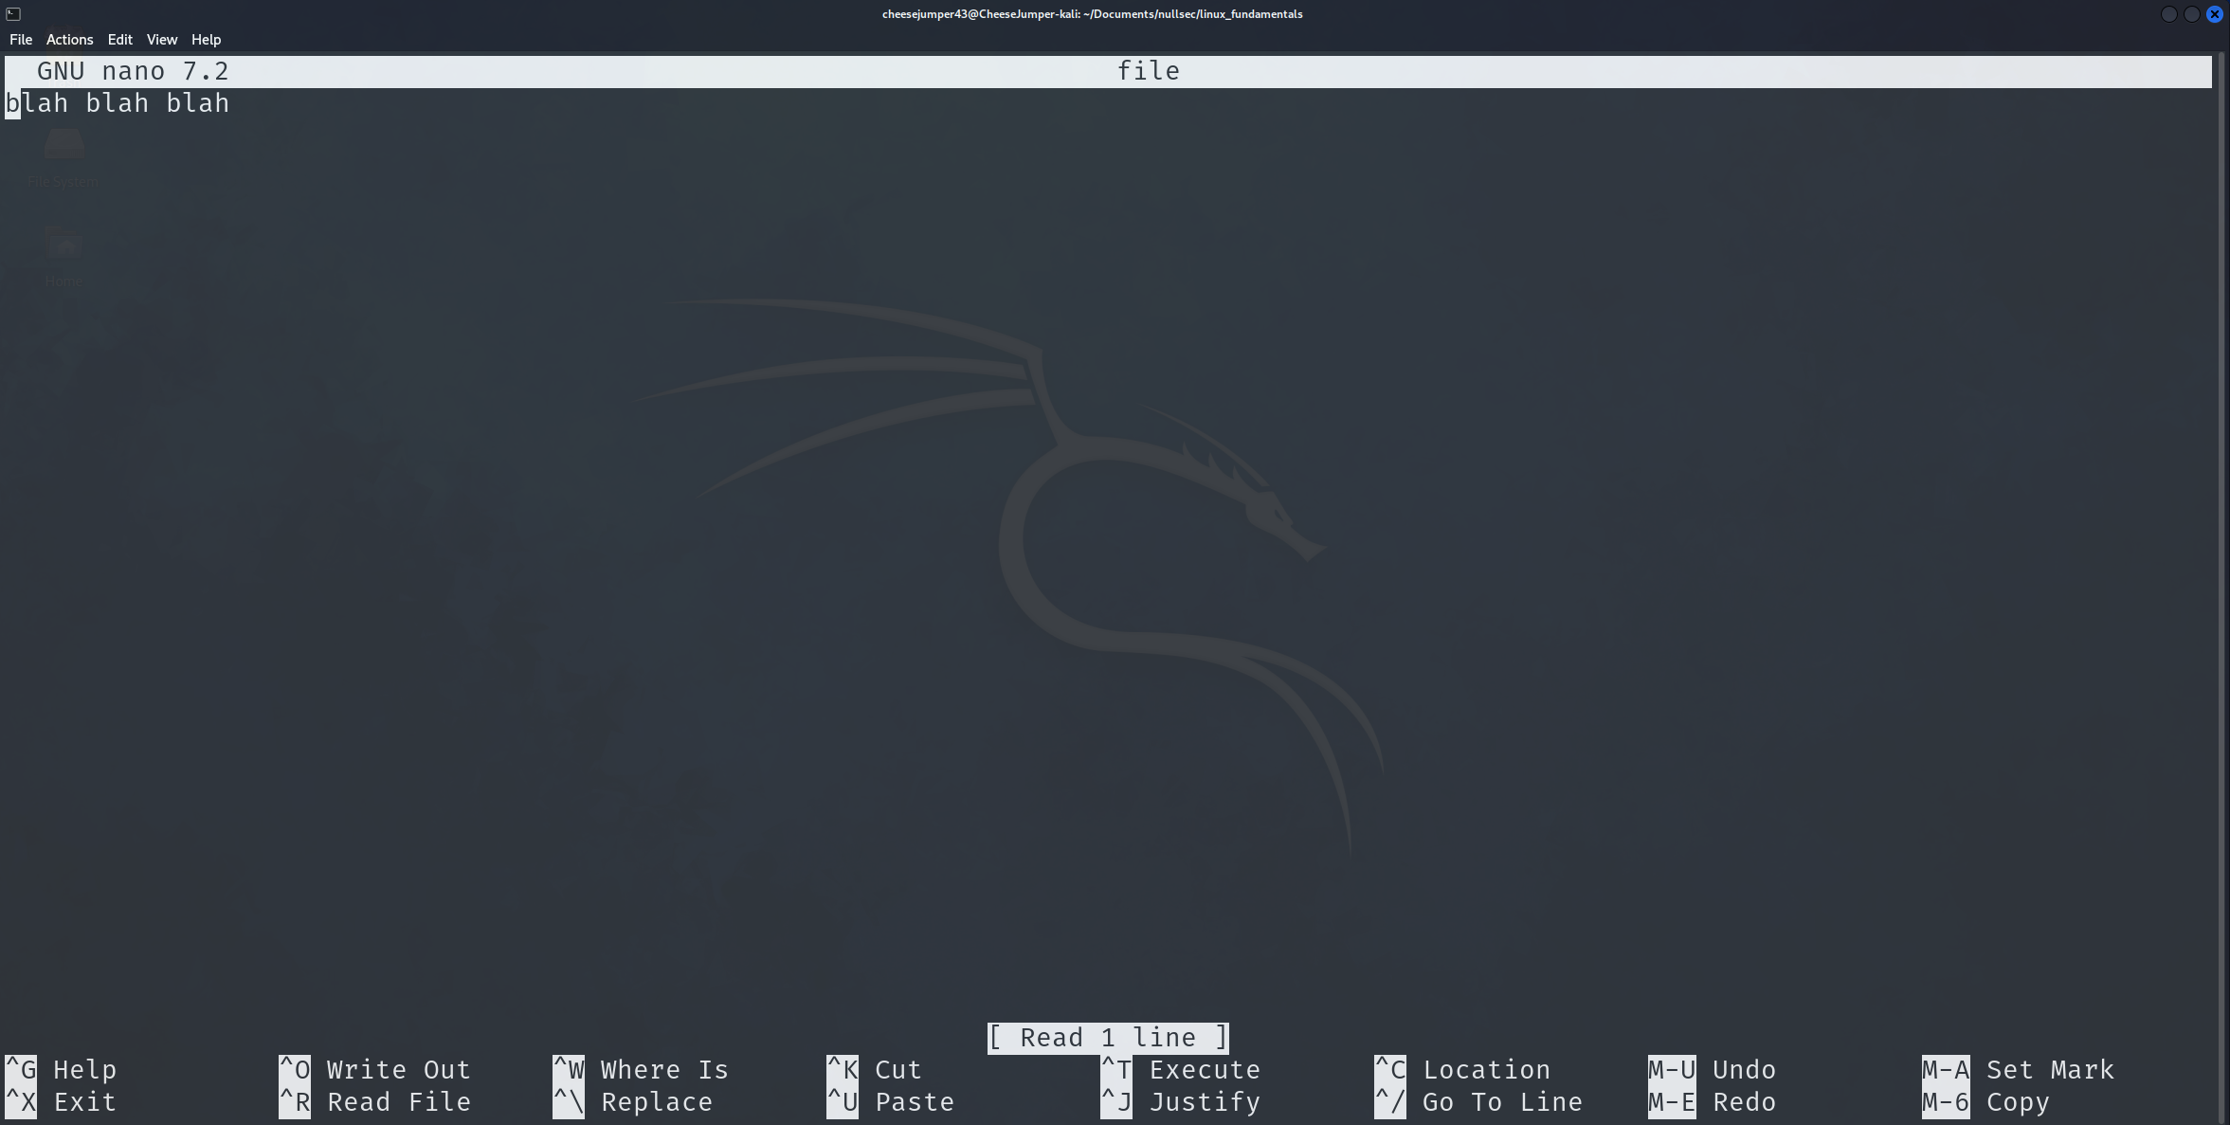
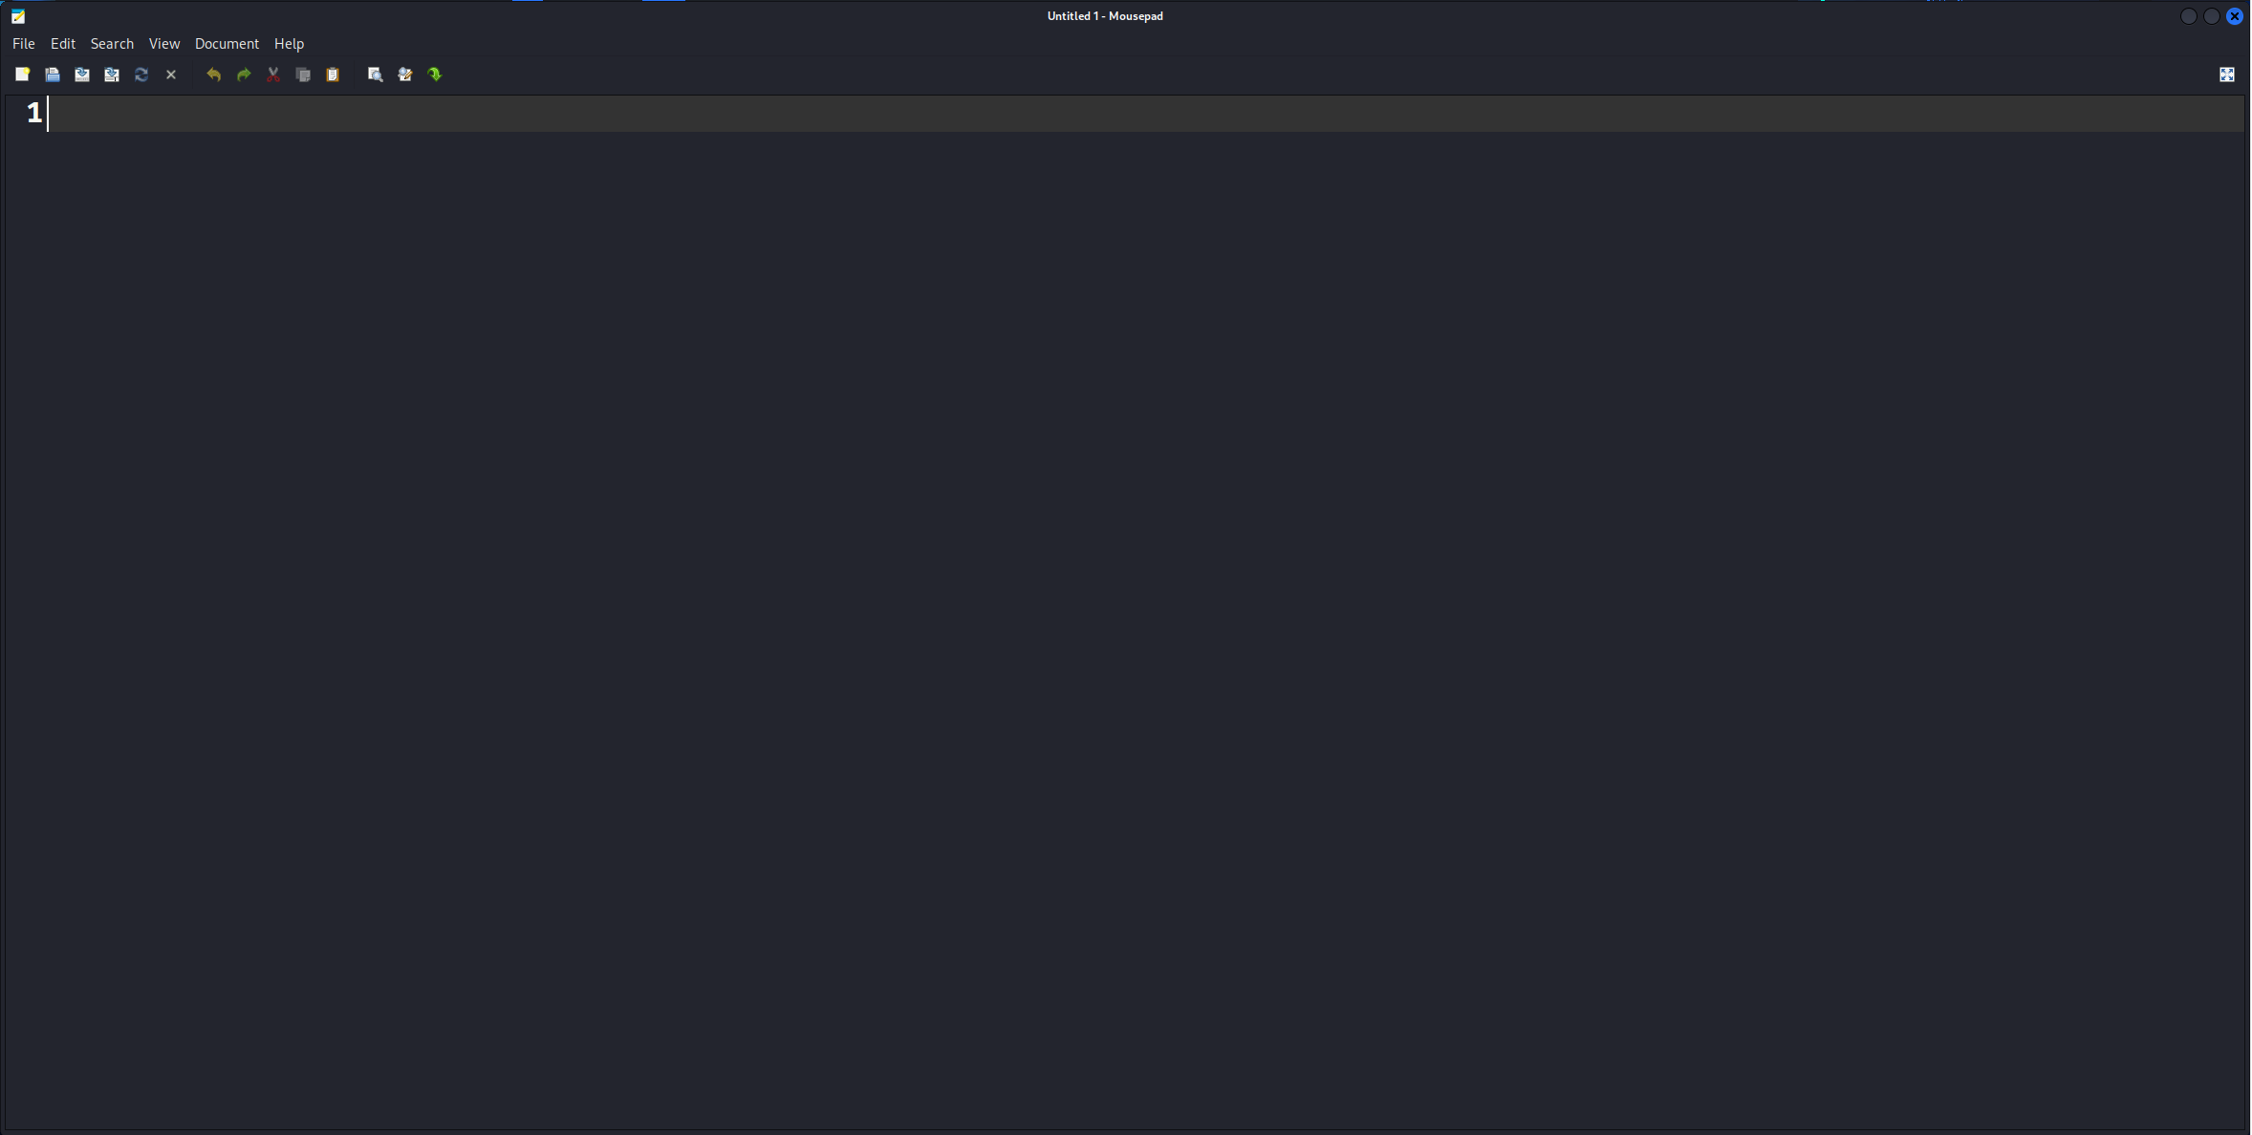
Writing to files
Open a file in nano
Should come pre-installed with kali
Ctrl +s to save, Ctrl + x to leave
User friendlier UI that can be interacted with using cursor
CLI based editor
GUI based text editor
nano
mousepad

Slide 22
CAT
Reveal contents of a file
View contents of a file
Display

Slide 23
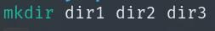
Directory management
Create a single file
Remove a single empty directory
Create multiple files
Remove multiple Directories
Make directory
rmdir
Remove file
mkdir

Slide 24
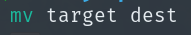
Copying and Moving
Can be used to move files / sub-directories into different parent directories
Can be used to copy files / sub-directories into different parent directories
Move file / directory
copy file / directory
mv
cp

Slide 25
User types
Super Users
Full access to entire file system
Can make, edit, or delete files as they please
Regular Users
Limited access
Full access to their own home directories

Slide 26
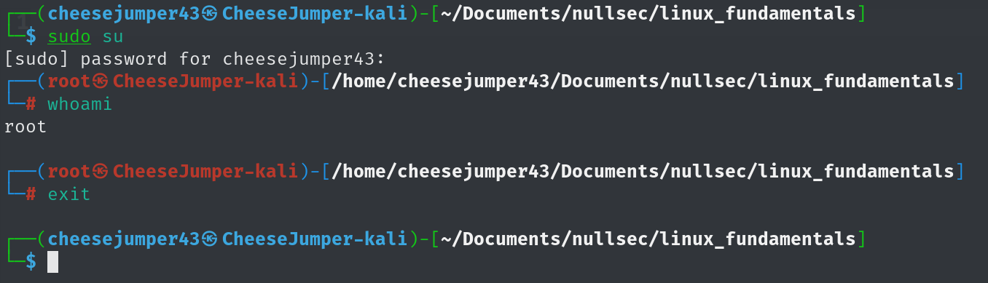
Becoming a super user
sudo (super user do) – temporarily elevate privilege when running command
su (Switch users) – switch user
sudo su – switch to root account (max Privilege)
Hint: password cannot be seen when being entered
VM Credentials: ycep24:ycep24

Slide 27
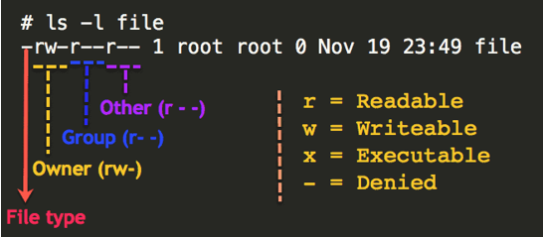
Permissions
4 stands for “read”
2 stands for “write”
1 stands for “execute”
0 stands for “No permissions
Notes:
Source: http://www.thegeekdiary.com/understanding-basic-file-permissions-and-ownership-in-linux/

Slide 28
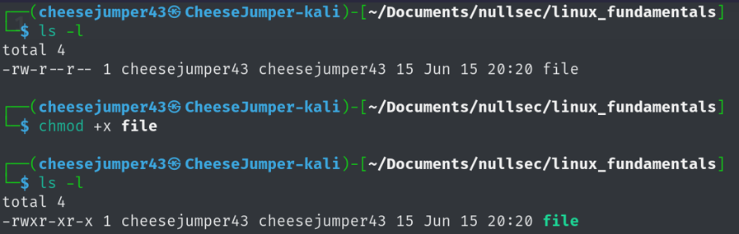
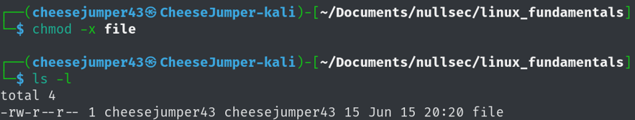
CHMOD
+X added execute perms for all
-x removed execute perms for all
*Executables cannot be run without the correct perms
Change file permissions
chmod

Slide 29
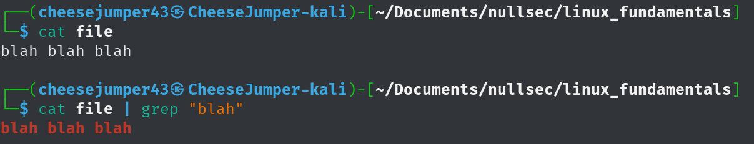
Grep
Search text or files for specific patterns
grep

Slide 30
WGET and UNZIP
wget
Download link
unzip
Zipped file
Download files from the internet
Unzip files
wget
unzip

Slide 31
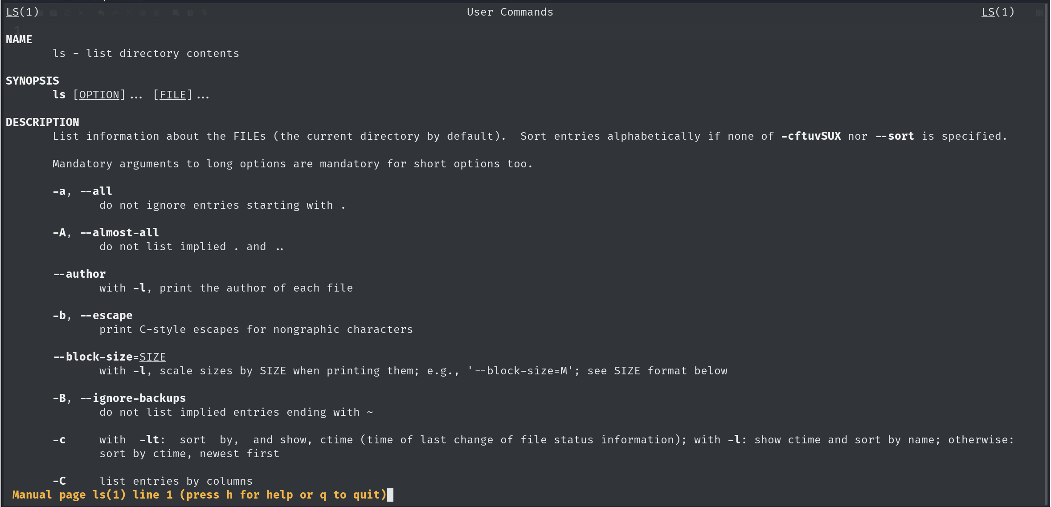
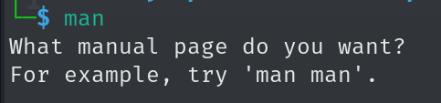
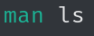
MAN
Command
Display user manual
man

Slide 32
/03
Introduction to Kali Linux
WORKSHOP.HTML

Slide 33

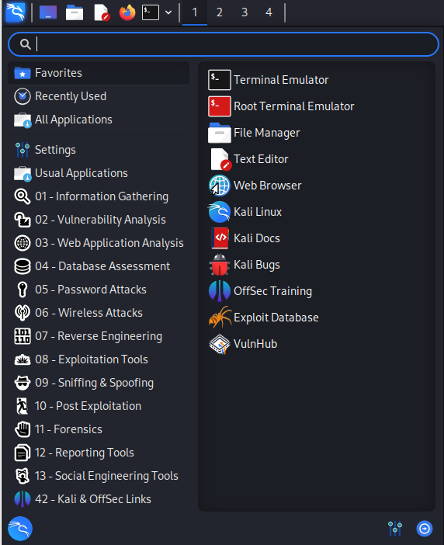
Kali Linux
Security focused operating system
Well established, and backed by a strong community
Comes with over 600 pre-installed penetration testing tools, sorted by category
Compatible with a variety of devices
Notes:
Kernels exists at the core of operating systems,
Add comparisons

Slide 34
/04
Kali Linux Tools
DIGITAL-FORENSICS.HTML

Slide 35

netcat
Networking utility program for reading/writing to network connections
Uses:
Data transfer
Relays
Port scanning
Reverse Shells
Creating chats
TCP commands
nc [options] hostname port
-z: port scan
-l: listen
-p: port
-v: verbose

Slide 36

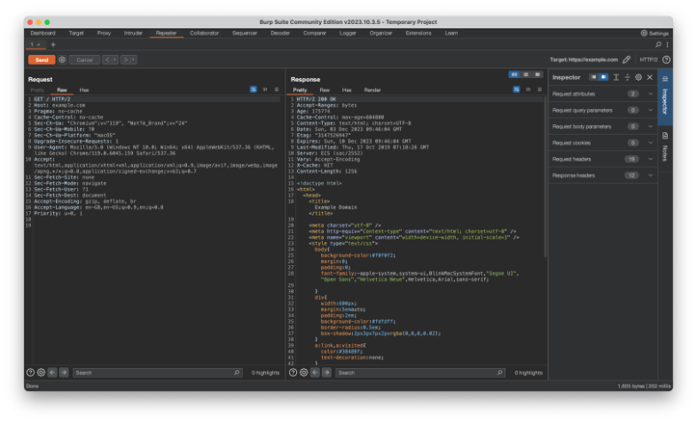
BurpSuite
Web application security testing
HTTP(s) / Websockets proxy & history
Tools: Repeater, Intruder etc
DEMO

Slide 37
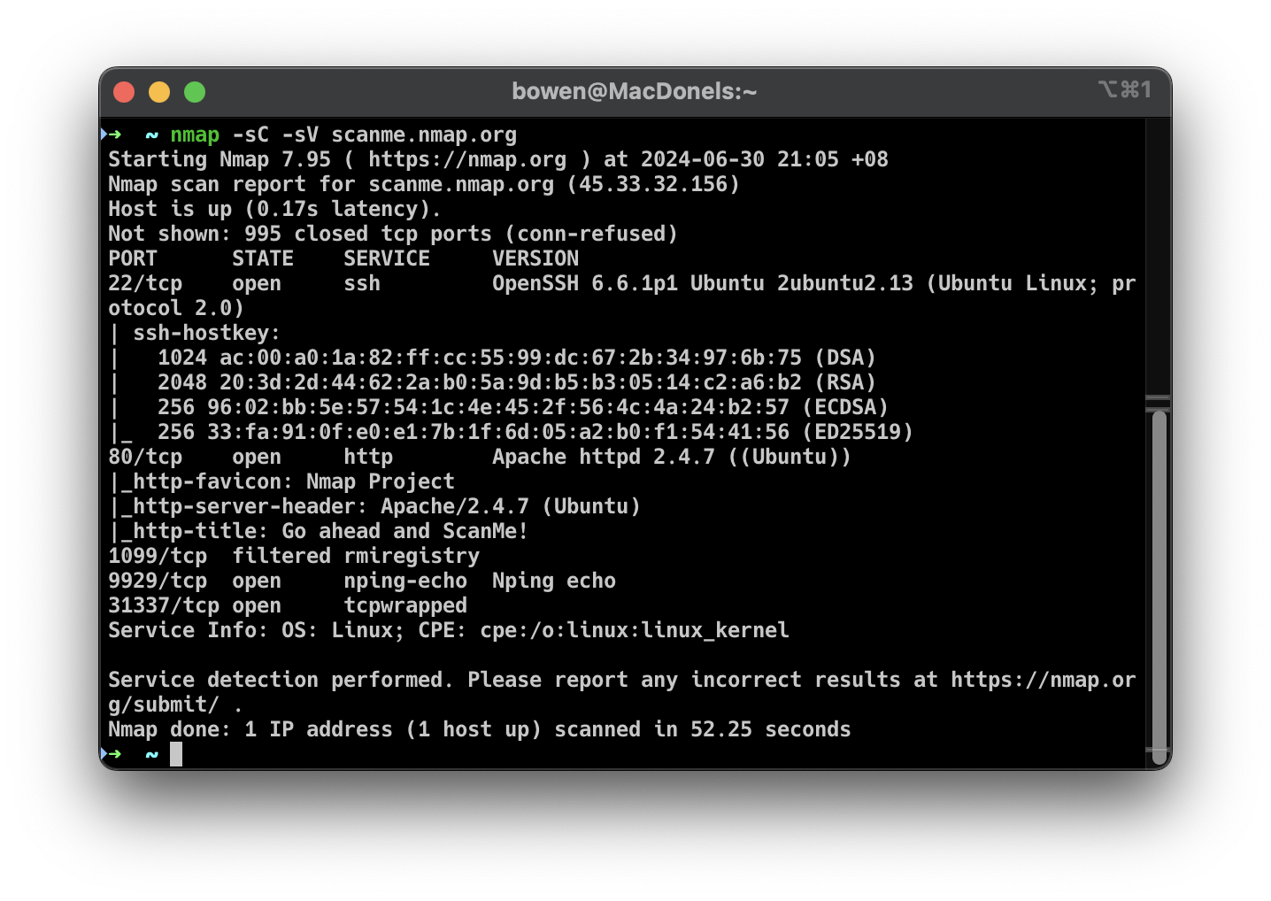
nmap
Reconnaissance tool used to scan IP address(es) for open ports
Used to find which IPs are being used
Used to see which services are running on a computer & exposed to the internet
nmap –sC –sV <IP Address>
Notes:
To find out about other flags, just Google
Or use the manpage hee hee

Slide 38
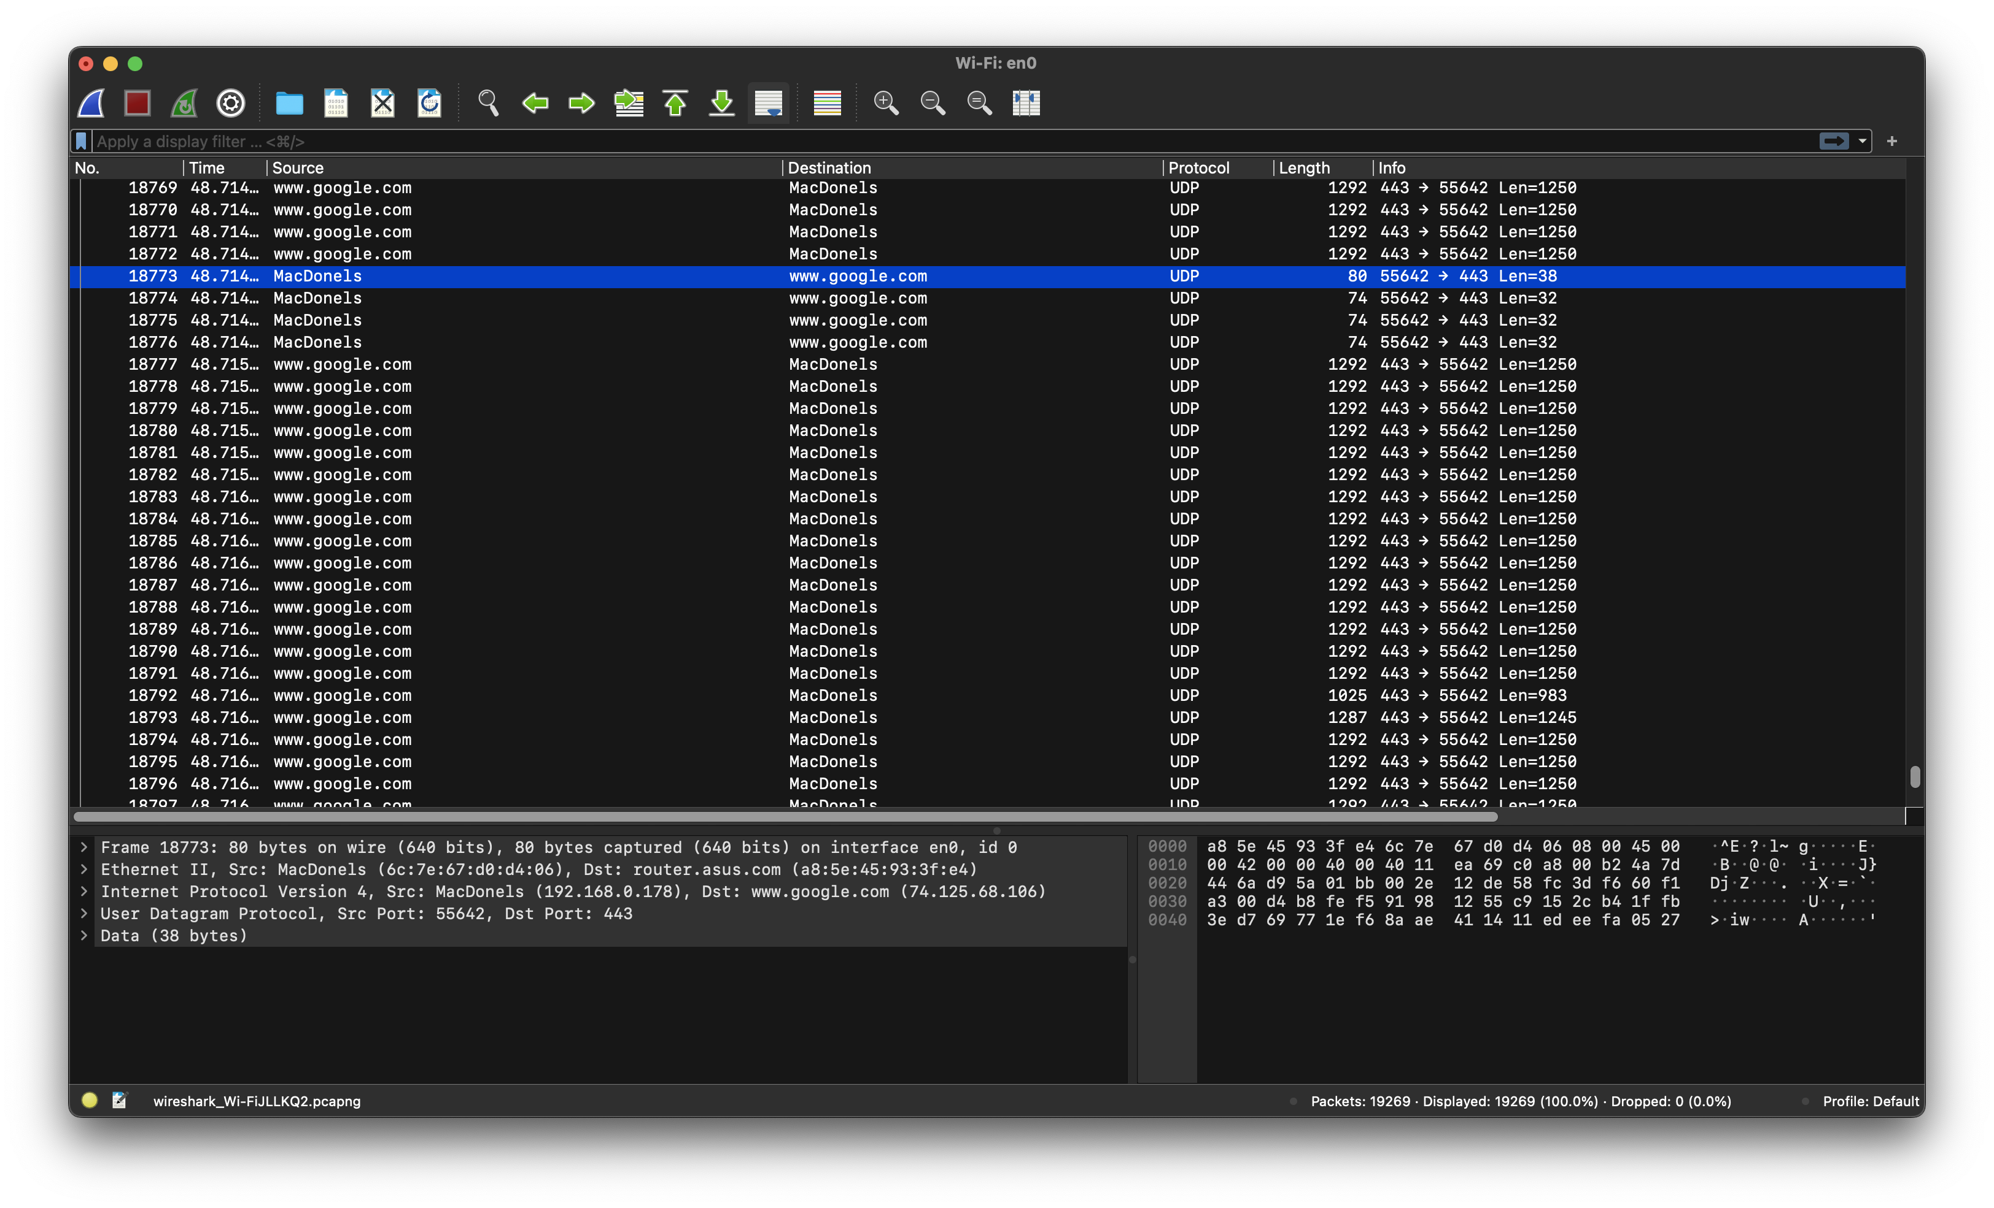
Wireshark
A tool to view and analyse network packets going through your WiFi
Used to intercept and view packets
Unencrypted protocols like HTTP can be viewed with this tool
Let’s see how we can view HTTP requests!!

Slide 39

/05
CTF Time!!
WORKSHOP.HTML

Slide 40

<Mini CTF>
Time to apply what you’ve learnt hehehehe
WORKSHOP.HTML

Slide 41
Thank you for your feedback!!
WORKSHOP.HTML

Slide 42

Thank you!

